Slide 1
Data Science Competition
Lilly Sharples, Kavya Ahuja, Lakshmi Yetukuri, Nachiket Hinge

Slide 2
Goal
Given historical data, build models to review credit card applications and determine if they should be approved or denied
To accomplish this goal, we were provided with three datasets (csv files) of historical data, containing the default indicator value as well as 20 predictor values:
Training set with 20,000 account entries
Testing set with 5,000 account entries
Validation set with 3,000 account entries
Notes:
Nachiket

Slide 3
Data
It was necessary to import these files into a Pandas dataframe
Two predictor value columns had null values. We replaced the null values with the mean value of the column.
‘Uti_card_50plus_pct’- 2055, 499, and 297 null values across the training, test, and validation sets
‘Rep_income’- 1570, 383, and 253 null values across the training, test, and validation sets
Data had to be scaled to be used in the logistic regression model
Used StandardScaler() from the scikit learn preprocessing package
Standard score = (score - mean)/std.dev.
Experimented with overfitting the data using SMOTE(Synthetic Minority Over-Sampling Technique) from imbalanced-learn library
Notes:
Nachiket

Slide 4
Logistic Regression Model
Logistic regression frameworks are used for predictive analysis when the dependent Y value is binary, as it was in our problem. The purpose is to calculate the probability of a binary event occurring, based on occurrences in the training set.
We used the LogisticRegression() model from sklearn.linear_model, and trained this model on the scaled data
All 20 features were incorporated when training this model, resulting in a test set accuracy of 0.9354, and a validation set accuracy of 0.942
Notes:
Lakshmi

Slide 5
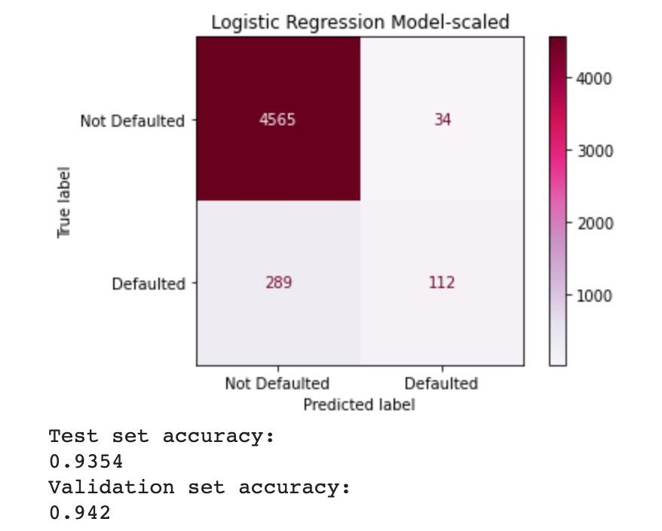
Logistic Regression Model Confusion Matrix
Notes:
Lakshmi

Slide 6
Random Forest Model
Random Forest models combine the output of multiple decision trees in order to arrive at the final predicted outcome. A benefit of these models is that there is a reduced risk of overfitting the data, and it is easy to determine feature importance. Additionally, Random Forest can handle large amounts of training data.
We used the RandomForestClassifier from sklearn.ensemble with 64 trees
The model was first trained on the dataset of all 20 features, giving a test set accuracy of 0.936 and a validation set accuracy of 0.939
Exploring the feature importance showed that the ‘auto_open_ 36_month_num’ and ‘ind_acc_XYZ’ features were the two least important features, so we removed and retrained the model to get a very slight increase in accuracy: test set accuracy of 0.9362 and a validation set accuracy of 0.942
Notes:
Lilly
Random forest has a method to get a list of all feature importances used in training the model. When the different variable are thoroughly analyzed, you notice that one variable holds a small or large significance compared to the next in determining the output which is the response.
Auto_open_36_month_num is the number of auto loans opened by the applicant in 36 months, with a feature importance of 0.0064
ind_acc_XYZ indicates if the applicant already had an account with the bank, with a feature importance of 0.0078

Slide 7
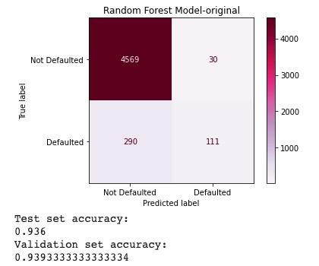
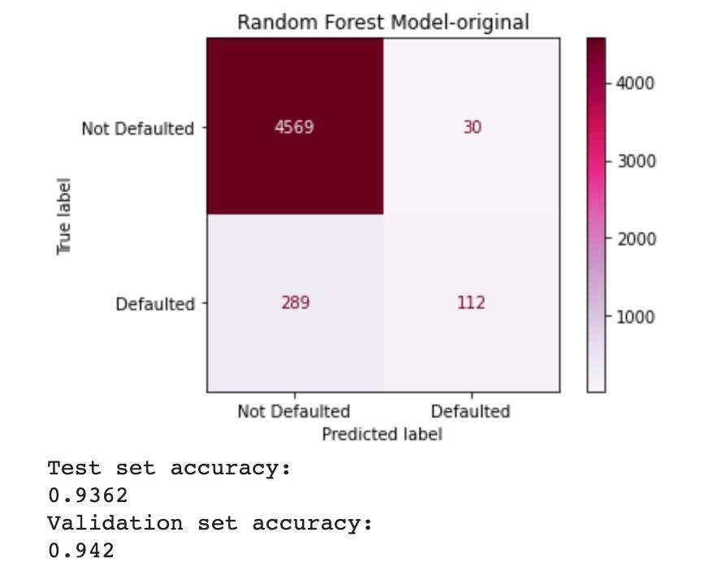
Random Forest Confusion Matrices
Before removing features After removing features
Notes:
Lilly

Slide 8
Gradient Boosting
Gradient Boosting builds decision trees one at a time, and each tree helps to correct the errors made by the previously trained tree . Gradient boosting(GBM) focuses step by step, which works well with a unbalanced data set.
We used the GradientBoostingClassifier from sklearn.ensemble
The Gradient Boosting Model was created to test the classifier’s performance at different learning levels. The best performance came at a learning rate of 0.5, with a test set accuracy of 0.937 and a validation set accuracy of 0.936
We were able to find this optimal learning rate by iterating through learning rates between .05 and 1.
Notes:
Kavya

Slide 9
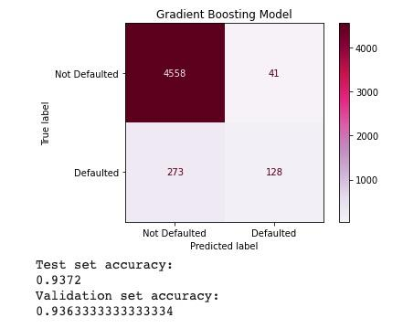
Gradient Boosting Confusion Matrix
Notes:
Kavya 4558/5000 (91.6%) true positive **wait for lakshmi to talk about neural nets

Slide 10
Overall Results
Logistic Regression: test accuracy-0.9354
Random Forest: test accuracy-0.9362
Gradient Boosting: test accuracy-0.9372
Though all models had similar accuracies, the Gradient Boosting is the most accurate when run on the testing data.
Notes:
Kavya

Slide 11
Real World Application
When a customer is looking to apply for a credit card, they should give the bank as many of the features as they have, marking the rest as null. Then, their profile would be run through our Gradient Boosting model, predicting either a 0 or 1. A 1 means the customer is likely to default their account in the first 18 months, meaning they do not make payments for three consecutive months. We would be more inclined to deny these customers. A 0 means the customer is not predicted to default their account, so we would be more inclined to accept these customers.
We can assume our model would be 93.72% accurate at predicting if a customer is approved, they will not default their account in the first 18 months.
Notes:
Lilly

Slide 12
Conclusion
The most accurate model, Gradient Boosting, only has aa 93.72% accuracy. It is fairly accurate, however there is a chance where a credit card application that deserved a card is rejected. I would recommend, until a better or more accurate model is created, to have in-person jobs that will review the credit card applications for applications that do seem worthy. I would tell my customer, the model stated that your credit card application has been denied, but someone will look into and determine if you will be granted a credit card.
Notes:
Nachiket

Slide 13
Questions?
We will now answer any questions regarding our models, and the process behind creating them.
Thank you for your time in listening to our presentation!
Notes:
Nachiket

